Slide 1
Organizing Sexual Health Service Availability in Toronto

Slide 2
Describing the problem
Having access to proper sexual education/information as well as knowledge of how to access sexual health services is crucially important for teenagers, parents, and educational institutions.
For the benefit of those concerned, this project outlines the locations of, services offered by, and contact information for various sexual health/information centers in the Toronto area as well their proximity to educational institutions.
These center provide invaluable services such as counseling, providing birth control and abortion information and services, information on safe sex and hazards such as pregnancy and STIs, etc.

Slide 3
Interested parties
-Parents and guardians looking for nearby sources of reliable information, help and care for their children about their sexual experiences and potential problems stemming from them, especially ones located nearby to their places of residence or education.
-Teenagers looking for the same information since parents or guardians might not be best equipped to explain or help them through problems they may be experiencing.
-Schools that might seek to better inform their students about what they might encounter during their scholastic careers or later in life, and seek resources to help for sexual health classes and want their students to know about outside resources and how they can be accessed.

Slide 4
Data acquisition and cleaning
Data tables for Toronto Sexual Health Services as well Education Centers was acquired from Toronto Open Data at https://open.toronto.ca/dataset/school-locations-all-types/ and https://open.toronto.ca/dataset/wellbeing-youth-sexual-health-services/. Latitude and longitude data for sexual health centers was acquired at https://www.latlong.net/convert-address-to-lat-long.html. Redundant columns were dropped when information thy provided was also found in other columns.
Educational Datatable Features:
Name, Board Name, Source Address, School Type, School Type Description, Address Full, Postal Code, Municipality, City, Place Name, Latitude, Longitude (12 features total)
Sexual Health Center Datatable Features:
Agency Name, Organization Address, Office Phone #, Email, Website, Eligibility Criteria, Description of Services, Application, Languages, Accessibility, Hours, Legal Status, Date Updated, Longitude, Latitude, Full Address, Municipality, Postal Code (18 features total)

Slide 5
Data
To create the map shown in the presentation as well as allow it be explorable through the Python code provided, I first used the folium library to create a map of Toronto to overlay the points representing the various points of interest (education/sexual health centers). After that, I collected the latitude and longitude coordinates for the sexual health centers, which were not provided in the dataset originally.
I also created another dataset to easily categorize the services provided by each center by keyword for less tedious access, which can viewed through the code.

Slide 6
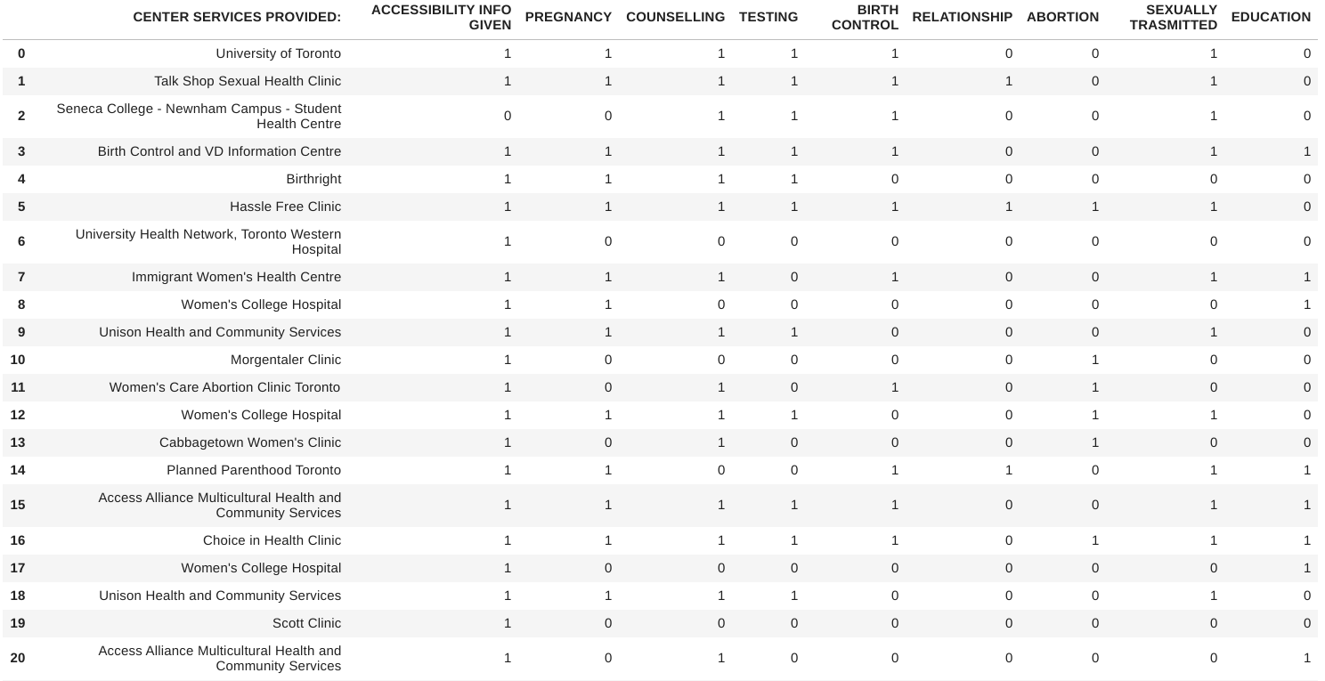

Slide 7
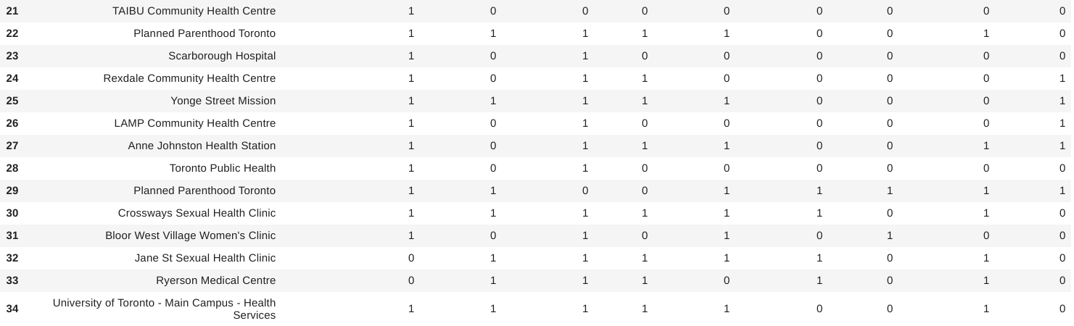

Slide 8
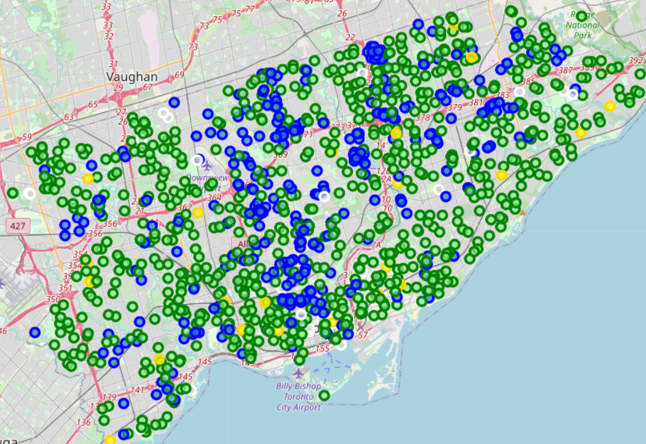
Green- English Separate
Blue- Private School
Yellow- French Separate
White- University

Slide 9
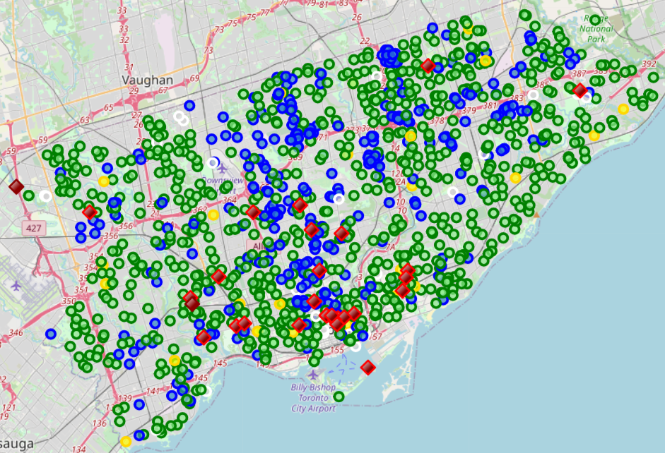
Bright Red- Sexual Health Center, Accessibility Info Listed
Dark Red- No Accessibility Info Listed

Slide 10
Conclusion and future directions
The data in this project will hopefully allow those concerned to be better informed about the availability of sexual health services in Toronto. The majority of these facilities seem to be clustered in the southern region of the city, becoming much sparser as they move farther out. Parents should try to take these facts into consideration and pay close attention to the curriculum for sex ed. in the school they enroll their children in, especially if they are intending to or only able to access one of the schools on the outer rim of the city.
In future, it would help to have access to data about the distribution/amount of sexual health related problems young people in the area most frequently deal with and in what areas in order for schools/parents to know which facilities to refer students to in sexual education, as well as where new service might be needed. Such data could not be found for this project.

